Slide 1
Examples on
Entropy Rate and Channel Capacity (2)
Qifu Tyler Sun

Slide 2
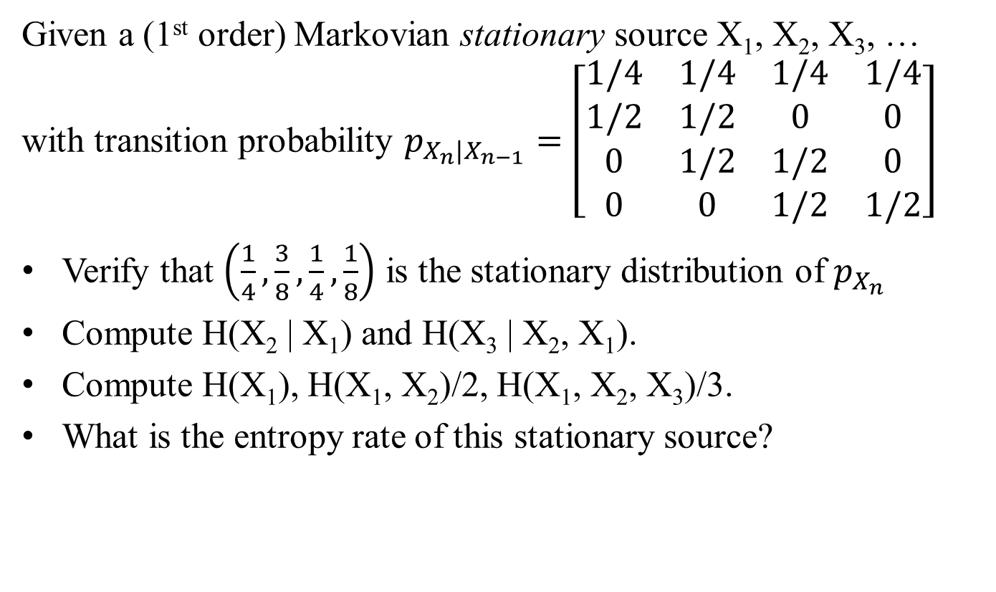
Entropy Rate of a Markovian Source

Slide 3
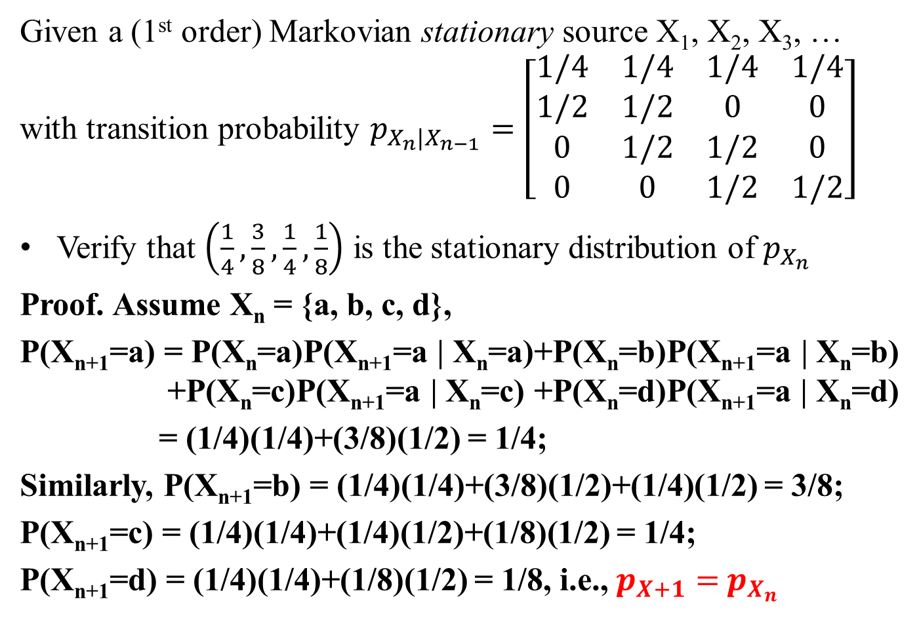
Entropy Rate of a Markovian Source

Slide 4
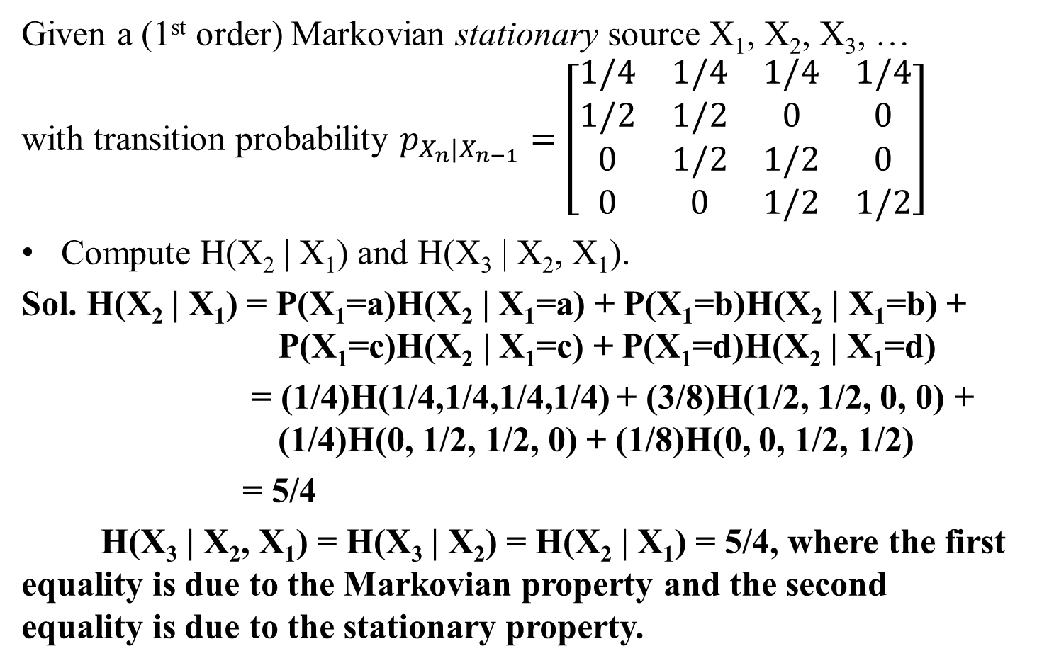
Entropy Rate of a Markovian Source

Slide 5
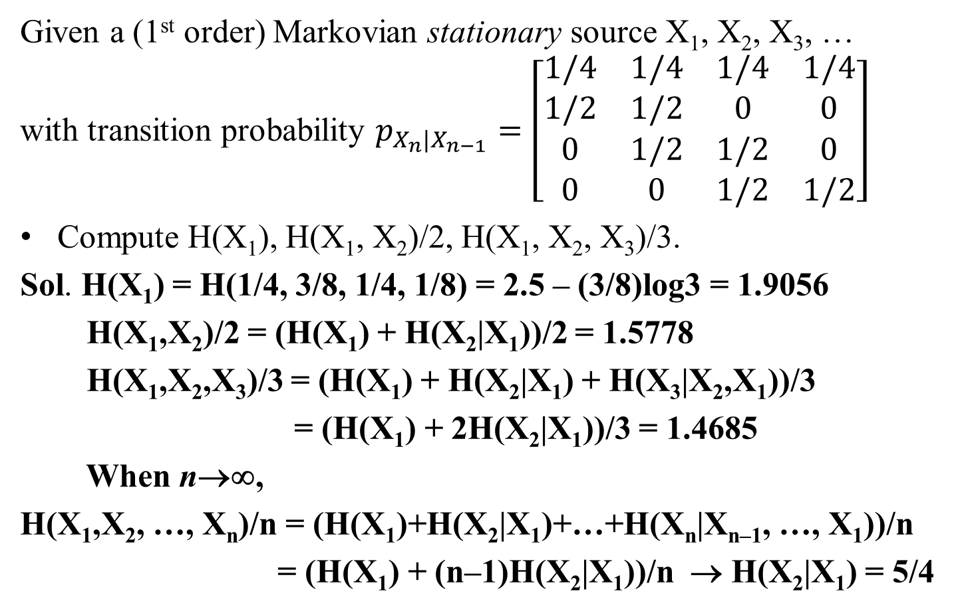
Entropy Rate of a Markovian Source

Slide 6
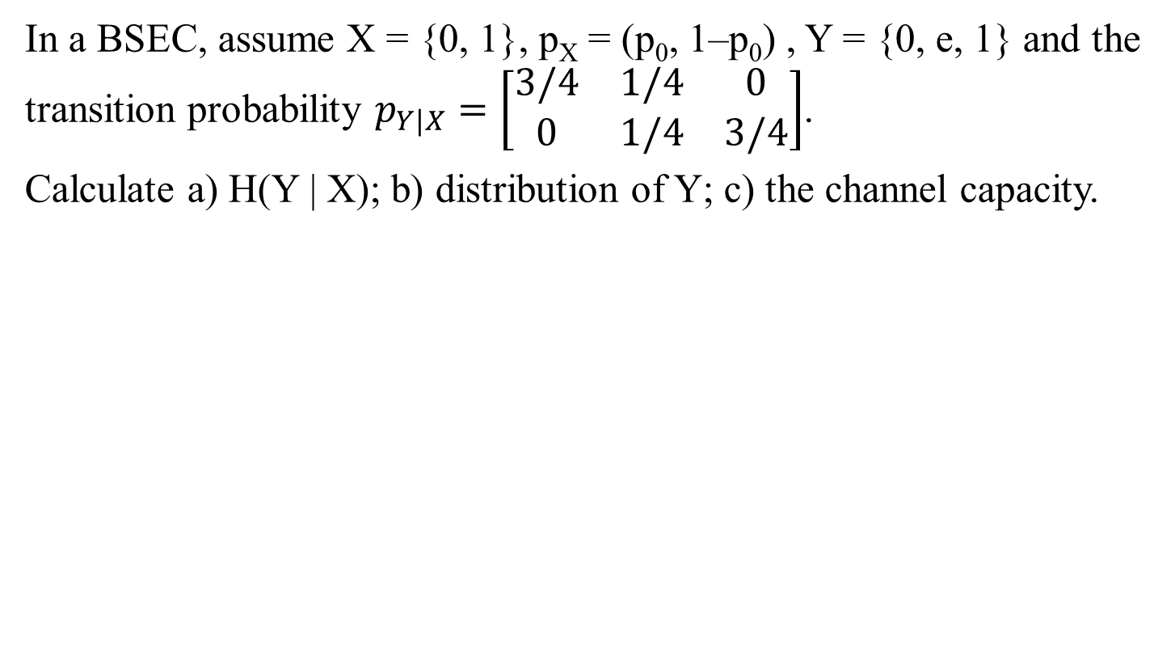
Capacity of a discrete memoriless channel

Slide 7
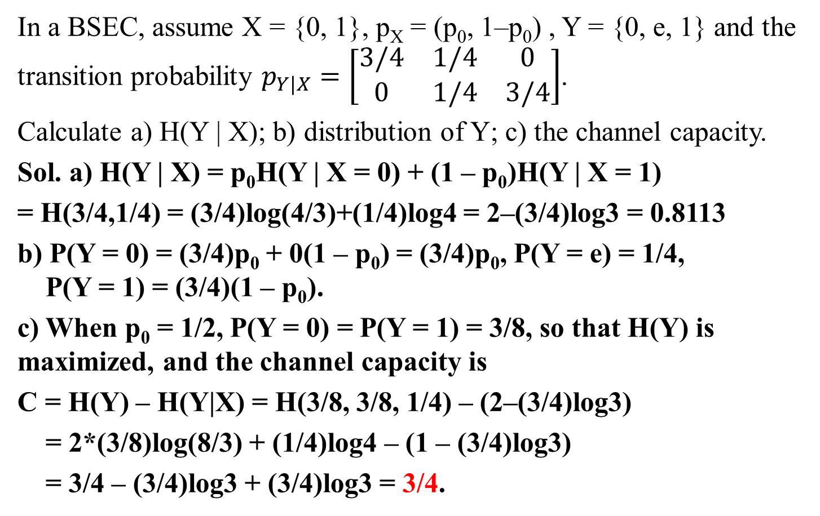
Capacity of a discrete memoriless channel

Slide 8
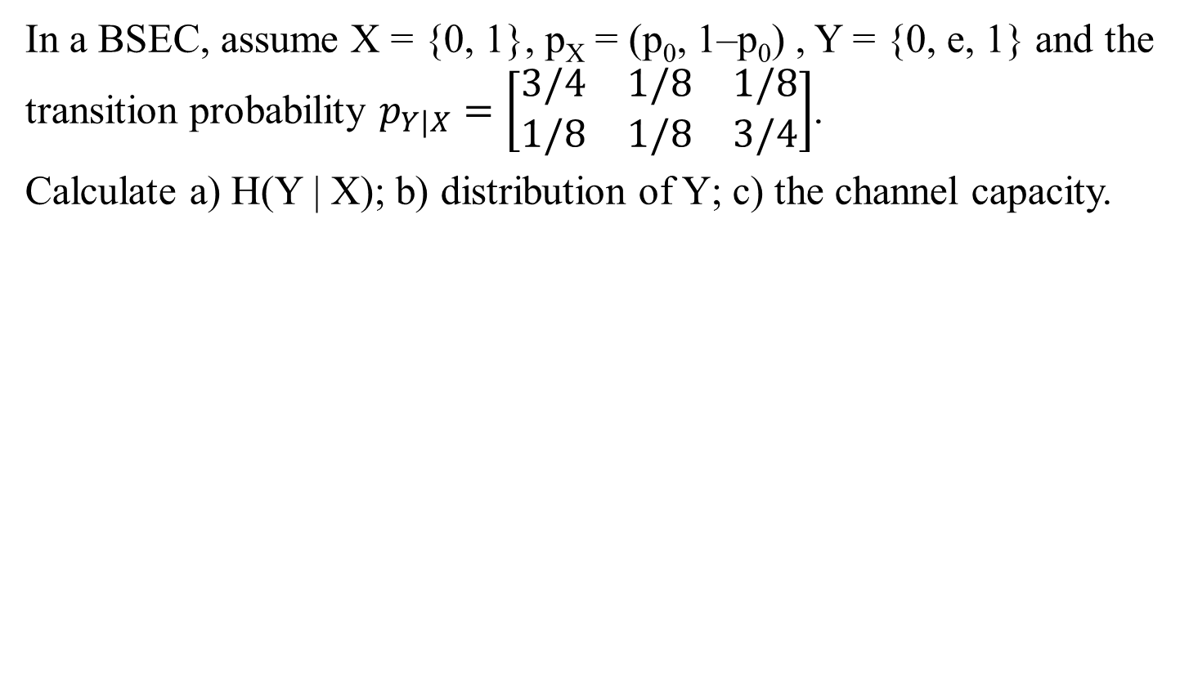
Capacity of a discrete memoriless channel

Slide 9
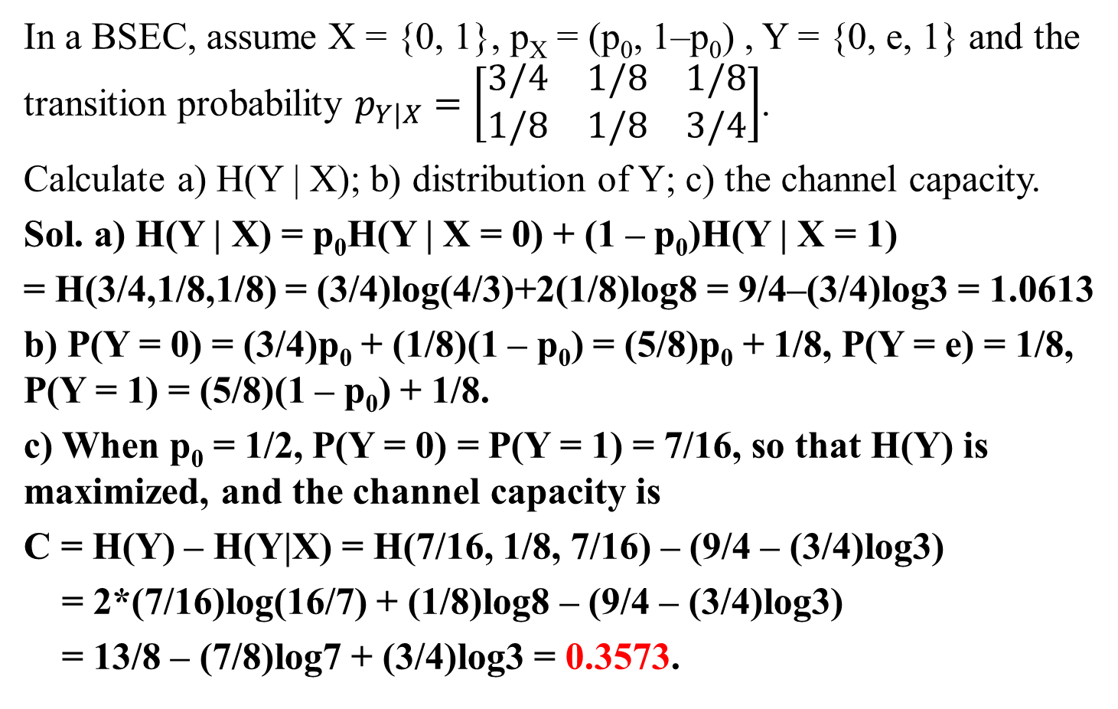
Capacity of a discrete memoriless channel

